Slide 1

The History of Information Technology and Ethics
Five Revolutions from Writing to the Web
Brendan Shea, PhD
Rochester Community and Technical College PHIL 1150: Computing and AI Ethics

Slide 2
Before We Begin: Who Is Complaining, and About What?
Someone, somewhere, about some new technology
“This invention will produce forgetfulness in the minds of those who learn to use it, because they will not practice their memory.
You offer your pupils the appearance of wisdom, not true wisdom, for they will read many things without instruction and will therefore seem to know many things, when they are for the most part ignorant.”
Commit before we go on
What technology is being attacked here? Who is speaking, and what year? Write down your guess — no consulting your phone.

Slide 3
The Answer: Socrates, About Writing, c. 370 BCE
Plato, Phaedrus 275a–b. Socrates relays King Thamus’s verdict on the god Theuth, who has just invented writing and is proud of it.
Why start a course on AI ethics here
Every charge we now level at phones, social media, and chatbots — that they rot memory, counterfeit understanding, and substitute the appearance of knowing for the real thing — was leveled first at the alphabet, and then at printing, the telegraph, radio, and television.
That is not a reason to dismiss the charge. Sometimes the critics were right. The point is that we have 2,400 years of data on how this argument goes, and we would be foolish not to look at it.

Slide 4
Central Questions
What are the five major IT revolutions, and what ethical patterns do they share?
Why does every revolutionary technology promise liberation yet enable new forms of control?
How have optimists and pessimists responded to each revolution—and who was right?
How do economic and political interests shape the impact of technology?
What historical lessons should we carry into our analysis of AI, IP, and surveillance?
Discussion
Can you think of a recent technology that promised freedom but has been used for control?

Slide 5
Lecture Outline
Introduction: Information Technology and Ethics
Revolution 1: Writing Revolution 2: The Printing Press
Revolution 3: Distance Communication Revolution 4: Mass Media
Revolution 5: The World Wide Web Conclusion: Patterns and Lessons

Slide 6
Why Start with History?
This course moves from history → ethical frameworks → contemporary issues. Understanding IT history matters because:
Patterns repeat: The "concerns" about social media echo Orwell’s and Arendt’s warnings about TV
Power matters: Technology serves whoever controls it—this lesson runs through every revolution
Speed of change: Digital tech disrupted IP law, surveillance systems, and labor—understanding this helps us think critically about AI
Key Insight
When debates about technology seem new, they’re often ancient questions in modern dress.
Discussion
Looking ahead to our study of virtues, free speech, IP, and AI—what historical lessons might apply?
6

Slide 7
What is Information Technology?
Definition: Technologies for creating, storing, transmitting, and processing
information.
Key Insight
Information technology is ancient—not just computers!
Writing | Printing | Telegraph | Radio-TV | Web
3200 BCE | 1440 CE | 1840s | 1920s | 1990s

Slide 8
What is Normative Ethics?
Definition: The branch of philosophy concerned with how we ought to act.
Three Branches of Ethics
Descriptive Ethics: What people do believe about right and wrong Normative Ethics: What people should believe about right and wrong Metaethics: The nature of morality itself (e.g., Are moral facts real?)
Key Insight
Ethics is also ancient—as old as philosophy itself!

Slide 9
The Five IT Revolutions
Roadmap for Today’s Lecture
We will examine five major information technology revolutions, each with its own debates, promises, and unforeseen consequences.
# Revolution
Approximate Date
∼3200 BCE
Key Thinkers
Socrates, Plato
Writing
Printing Press
Distance Communication
Mass Media
The Web
∼1440 CE
∼1840s
∼1920s
∼1990s
Luther, Erasmus
Mill, Marx Orwell, Arendt Current debates
Central Theme
Each revolution promised liberation—and each enabled new forms of control.

Slide 10
Lecture Outline
Introduction: Information Technology and Ethics
Revolution 1: Writing Revolution 2: The Printing Press
Revolution 3: Distance Communication Revolution 4: Mass Media
Revolution 5: The World Wide Web Conclusion: Patterns and Lessons

Slide 11
Revolution 1: A Brief History of Writing
Key Developments
Cuneiform in Mesopotamia (∼3200 BCE) Egyptian hieroglyphics (∼3100 BCE) Phoenician alphabet (∼1050 BCE) Greek alphabet (∼800 BCE)
Memory in minds
Oral Culture
Writing invented
Written Culture
Memory on tablets
Transition from oral to written culture
Writing as Memory Technology
Writing externalizes information—storing it outside the human mind for the first time.

Slide 12
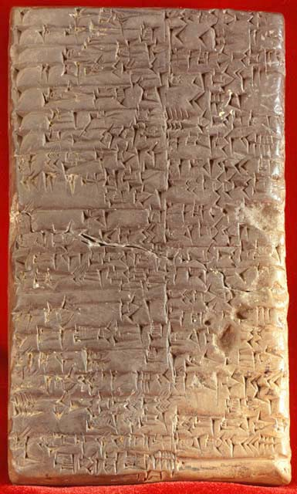
Cuneiform: The World’s First Writing System
Key Facts
Developed in Mesopotamia (modern Iraq), c. 3200 BCE Originally used for bookkeeping—tracking grain, cattle, and trade Impressed into wet clay tablets using a reed stylus Later adapted for laws, literature, and religion
Legacy
The oldest surviving literary work—the Epic of Gilgamesh—was recorded on cuneiform tablets around 2100 BCE.
Cuneiform tablet, c. 2041–2040 BCE. Kirkor Minassian collection, Library of Congress. Public domain.

Slide 13
Who Were Socrates and Plato?
Socrates (c. 470–399 BCE)
Athenian philosopher; wrote nothing Taught through dialogue and questioning The “Socratic method”: Learn by examining your own beliefs Executed for “corrupting the youth” We know him only through others’ writings
Plato (c. 428–348 BCE)
Socrates’s most famous student Founded the Academy in Athens Wrote dialogues featuring Socrates Key works: Republic, Phaedrus, Apology Preserved Socrates’s ideas in writing
The Central Irony
Socrates distrusted writing—but we only know this because Plato wrote it down. Would Socrates have approved of Plato’s project?
13

Slide 14
Socrates and Plato’s Worries About Writing
The Irony
Socrates never wrote anything down—yet we know his views through Plato’s written dialogues. The myth itself is almost certainly Plato’s own invention, not an Egyptian tradition he inherited: he wrote a story against writing, and it survives because he wrote it.
Inventor (Optimist)
Theuth
presents
Writing
Plato’s Phaedrus (c. 370 BCE)
Socrates tells the myth of Theuth and Thamus:
Theuth: Egyptian god who invents writing
Thamus: King who must judge the invention
Theuth claims writing will make people “wiser”
judges
Thamus
Judge (Skeptic)
The myth of Theuth and Thamus
14

Slide 15
Quote: Plato’s Phaedrus on Writing
, Plato, Phaedrus, 275a-b (Fowler trans.)
Context: King Thamus responds to Theuth’s claim that writing will improve memory and wisdom: “For this invention will produce forgetfulness in the minds of those who learn to use it, because they will not practice their memory. Their trust in writing, produced by external characters which are no part of themselves, will discourage the use of their own memory within them. You have invented an elixir not of memory, but of reminding; and you offer your pupils the appearance of wisdom, not true wisdom, for they will read many things without instruction and will therefore seem to know many things, when they are for the most part ignorant and hard to get along with, since they are not wise, but only appear wise.”
! Key Distinctions
Memory (internal) vs. Reminding (external) | True wisdom vs. Appearance of wisdom

Slide 16
Socrates’s Argument Against Writing
Argument in Standard Form
True knowledge requires active engagement, dialogue, and the ability to respond to questions.
Writing cannot respond to questions or adapt to its audience.
Writing therefore creates the appearance of wisdom without its reality.
∴ Writing is inferior to living discourse for producing genuine understanding.
Discussion
Is this argument sound—what might Socrates be missing? (The paradox: we only know his case against writing because Plato wrote it down.)

Slide 17
Social Consequences of Writing
f Harms
Imperial administration and control Social stratification: literate elite vs. illiterate masses Loss of oral traditions Bureaucratic power over individuals Propaganda becomes possible
, Benefits
Law codes (Hammurabi, Torah) Historical records and memory Literature and poetry Religious texts preserved Scholarship across generations Contracts and commerce
Key Insight
The same technology that enables law and literature also enables empire and control.

Slide 18
The Pattern Emerges
Promise of Liberation
Widespread Adoption
Unforeseen Consequences
Cycle repeats
New Forms of Control
Critical Reflection
Recurring Themes
New IT promises liberation and democratization Critics warn of unintended consequences Both turn out to be partially right The technology serves whoever controls it

Slide 19
Lecture Outline
Introduction: Information Technology and Ethics
Revolution 1: Writing Revolution 2: The Printing Press
Revolution 3: Distance Communication Revolution 4: Mass Media
Revolution 5: The World Wide Web Conclusion: Patterns and Lessons

Slide 20
Revolution 2: A Brief History of Printing
Key Developments
Chinese woodblock printing (9th century CE) Gutenberg’s movable type (∼1440, Mainz, Germany) Rapid spread across Europe: Venice, Paris, London Economics: Cost of a book drops dramatically
Scale of Change
Before printing: A single book might cost as much as a house. After printing: Books become affordable to the middle class.

Slide 21
Johannes Gutenberg and the Printing Press
Johannes Gutenberg (c. 1400–1468)
German goldsmith and inventor Developed movable type (∼1440) Key innovations: metal alloy type, oil-based ink, wooden press adapted from wine presses Gutenberg Bible (1455): First major book printed in Europe Died in relative obscurity
Type
Printing Press
The Impact
By 1500: ∼20 million books printed in Europe (vs. a few thousand manuscripts before)

Slide 22
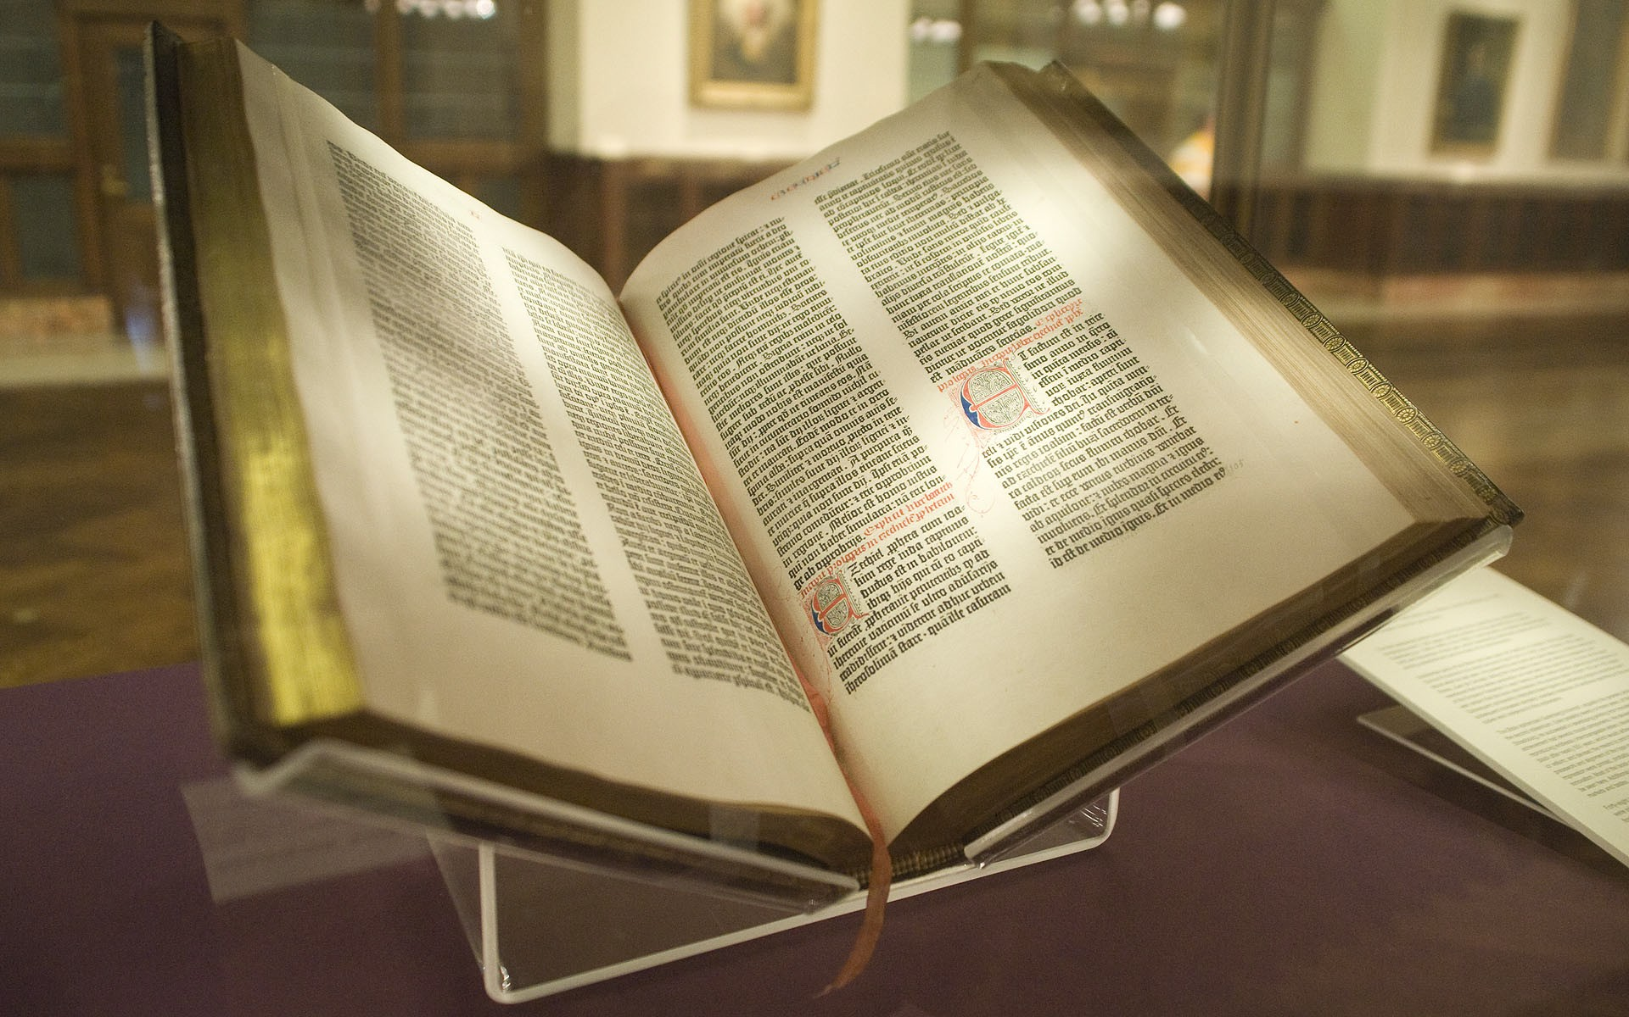
The Gutenberg Bible (1455)
The First Major Printed Book
Approximately 180 copies printed; about 49 survive Two folio volumes, 1,282 pages in total Quality rivaled the finest hand-copied manuscripts Each copy cost roughly 30 florins—about 3 years’ wages for a clerk
Why It Matters
The Bible was the era’s ultimate test case: could machine printing match the quality and authority of hand-copying?
Gutenberg Bible (Lenox Copy), New York Public Library. Photo: Kevin Eng. CC BY-SA 2.0.

Slide 23
Luther vs. Erasmus: Revolution vs. Reform
Martin Luther (1483–1546)
Used the press to spread radical reformation 95 Theses (1517) spread across Germany in weeks German Bible becomes a bestseller Saw printing as providential
Radical
Reform
Gradual
Luther
Erasmus
Key Question
Same technology, different visions—who gets to decide how it’s used?
Erasmus of Rotterdam (1466–1536)
Advocated gradual reform through scholarship Worried about unlearned masses reading complex texts

Slide 24
Quote: Martin Luther on Printing
, Martin Luther on the Printing Press
Context: Luther was among the first to grasp printing’s power: his 95 Theses (1517) spread across Germany in weeks, and his German Bible became a bestseller. For Luther, this was providential. “The art of book printing is the last and greatest gift because it is through this that the question of the true religion will become known to the entire world—to the very ends of the earth and in all languages—in accordance with God’s will. It is the inextinguishable flame of the world.” —attributed to Martin Luther, via Otto Clemen A note on sources: this famous quote circulates widely but cannot be traced to Luther’s own writings—it reaches us secondhand. (Sound familiar? We only know Socrates through Plato, too.)
! The Tension
Luther sees printing as divinely ordained for spreading truth. But the same press spreads what Luther would call error—and Luther’s own late polemic “On the Jews and Their Lies” was later cited by Nazis to justify anti-Semitic policies.
24

Slide 25
The Erasmian Counterargument
Argument in Standard Form
Rapid, uncontrolled spread of ideas leads to misunderstanding and conflict.
Complex theological and philosophical texts require learned interpretation.
The printing press enables unlearned masses to access such texts without guidance.
∴ Printing requires responsible gatekeeping and scholarly mediation.
Discussion
Both Luther and Erasmus have a point. Who gets to be the gatekeeper, who decides—and is there a middle ground?

Slide 26
Social Consequences of Printing: The Good
, Benefits of the Printing Revolution
Scientific Revolution: Sharing of data, replication of experiments, cumulative knowledge Mass literacy campaigns: Reading becomes a widespread skill Vernacular literature: National languages emerge (Dante, Shakespeare, Luther’s German) Religious diversity: Individual conscience, Protestant Reformation Philosophical treatises widely available (Enlightenment becomes possible) Standardization: Spelling, grammar, shared reference texts
The Promise Fulfilled
Printing did democratize knowledge and enable new forms of intellectual community.

Slide 27
Social Consequences of Printing: The Bad
f Dark Side of the Printing Revolution
Malleus Maleficarum (1487): The witch-hunting manual becomes a bestseller Anti-Semitic pamphlets: Pogroms spread with printed propaganda (e.g., Luther’s later writings) Religious wars: Thirty Years’ War (1618–1648) kills ∼8 million Propaganda and polarization: Pamphleteering as political warfare State power consolidated: Printed laws, surveillance records, bureaucracy
Discussion
Does the printing press bear responsibility for the witch trials—or is it just a tool? (The same press enabled the Scientific Revolution and mass propaganda.)

Slide 28
The Pattern Repeats
Writing
Preserve knowledge
Printing
Democratize knowledge Luther
Erasmus
Science, literacy, Enlighten-ment
Religious war, propaganda Who controls the press?
Promise Optimist Pessimist Benefits
Harms
Key Question
Theuth Thamus/Socrates
Law, literature, scholarship
Empire, bureaucracy Who controls access?
Emerging Insight
The technology amplifies human intentions—both good and bad. The question is always: Who controls it, and for what ends?

Slide 29
Lecture Outline
Introduction: Information Technology and Ethics
Revolution 1: Writing Revolution 2: The Printing Press
Revolution 3: Distance Communication Revolution 4: Mass Media
Revolution 5: The World Wide Web Conclusion: Patterns and Lessons

Slide 30
Revolution 3: The Technologies of the Long 19th Century
Key Innovations
Telegraph (1840s)—“The Victorian Internet” Telephone (1876)—Voice across distance Undersea cables—Connecting continents Postal systems and railroads—Physical distribution at scale Photography and recorded sound—New forms of documentation
The Optimistic 19th Century
Many believed these technologies would unite humanity and end war through better communication.

Slide 31
The Telegraph: “The Victorian Internet”
How It Worked
Morse code: Letters as electrical pulses (dots and dashes) Messages sent through copper wires Required trained operators at each end
The Hype
“The telegraph will unite all nations... Wars will cease to exist... The reign of peace will begin.” —Common 19th-century predictions
Key Milestones
1858: First transatlantic cable (failed after weeks)
1866: Permanent transatlantic connection
1870s: Global network connects continents
Sound Familiar?
Compare to claims about the internet “democratizing” information and “connecting” the world.

Slide 32
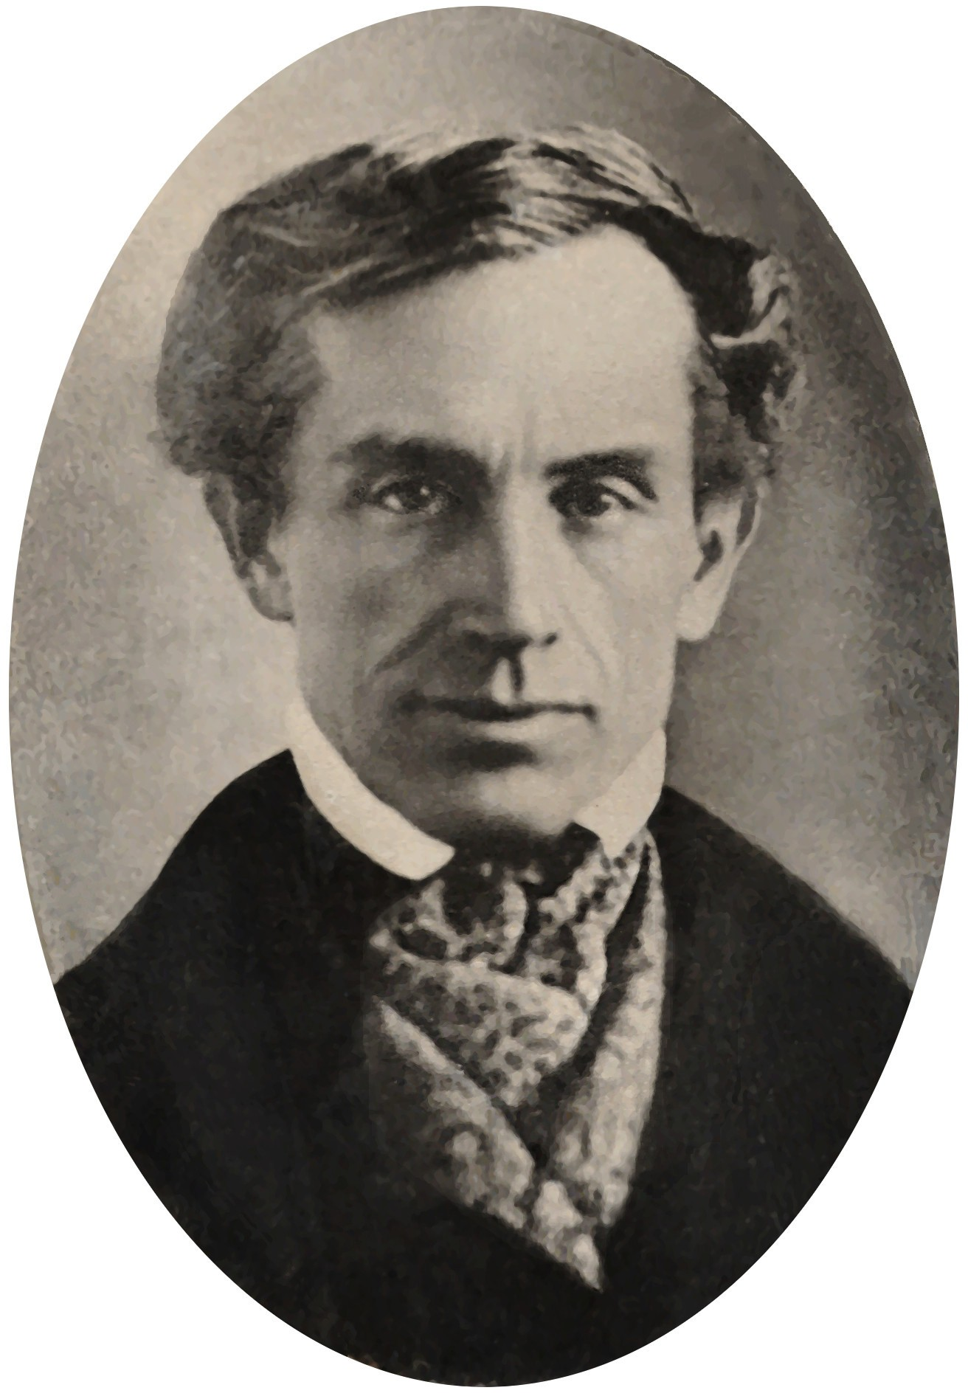
Samuel F.B. Morse: Artist Turned Inventor
Samuel Morse (1791–1872)
Began his career as a portrait painter—not an engineer Inspired to build the telegraph after his wife died while he was away on commission Developed Morse code in the 1830s: letters as electrical dots and dashes First message (1844): “What hath God wrought!” Became one of the wealthiest men in America
Samuel F.B. Morse, 1840. Archives of American Art, Smithsonian Institution. Public domain.

Slide 33
Who Were Mill and Marx?
Karl Marx (1818–1883)
German philosopher and economist Exiled from Germany, France, Belgium Lived in poverty in London Studied in British Museum library Founded communist theory Key works: Communist Manifesto, Das Kapital
John Stuart Mill (1806–1873)
British philosopher and economist Child prodigy; educated by his father Member of Parliament (1865–68) Champion of individual liberty Early advocate for women’s rights Key work: On Liberty (1859)
Why Their Debate Matters
Mill and Marx offer fundamentally different analyses of technology and power that still shape debates today: Is technology neutral, or does it serve whoever owns it?
33

Slide 34
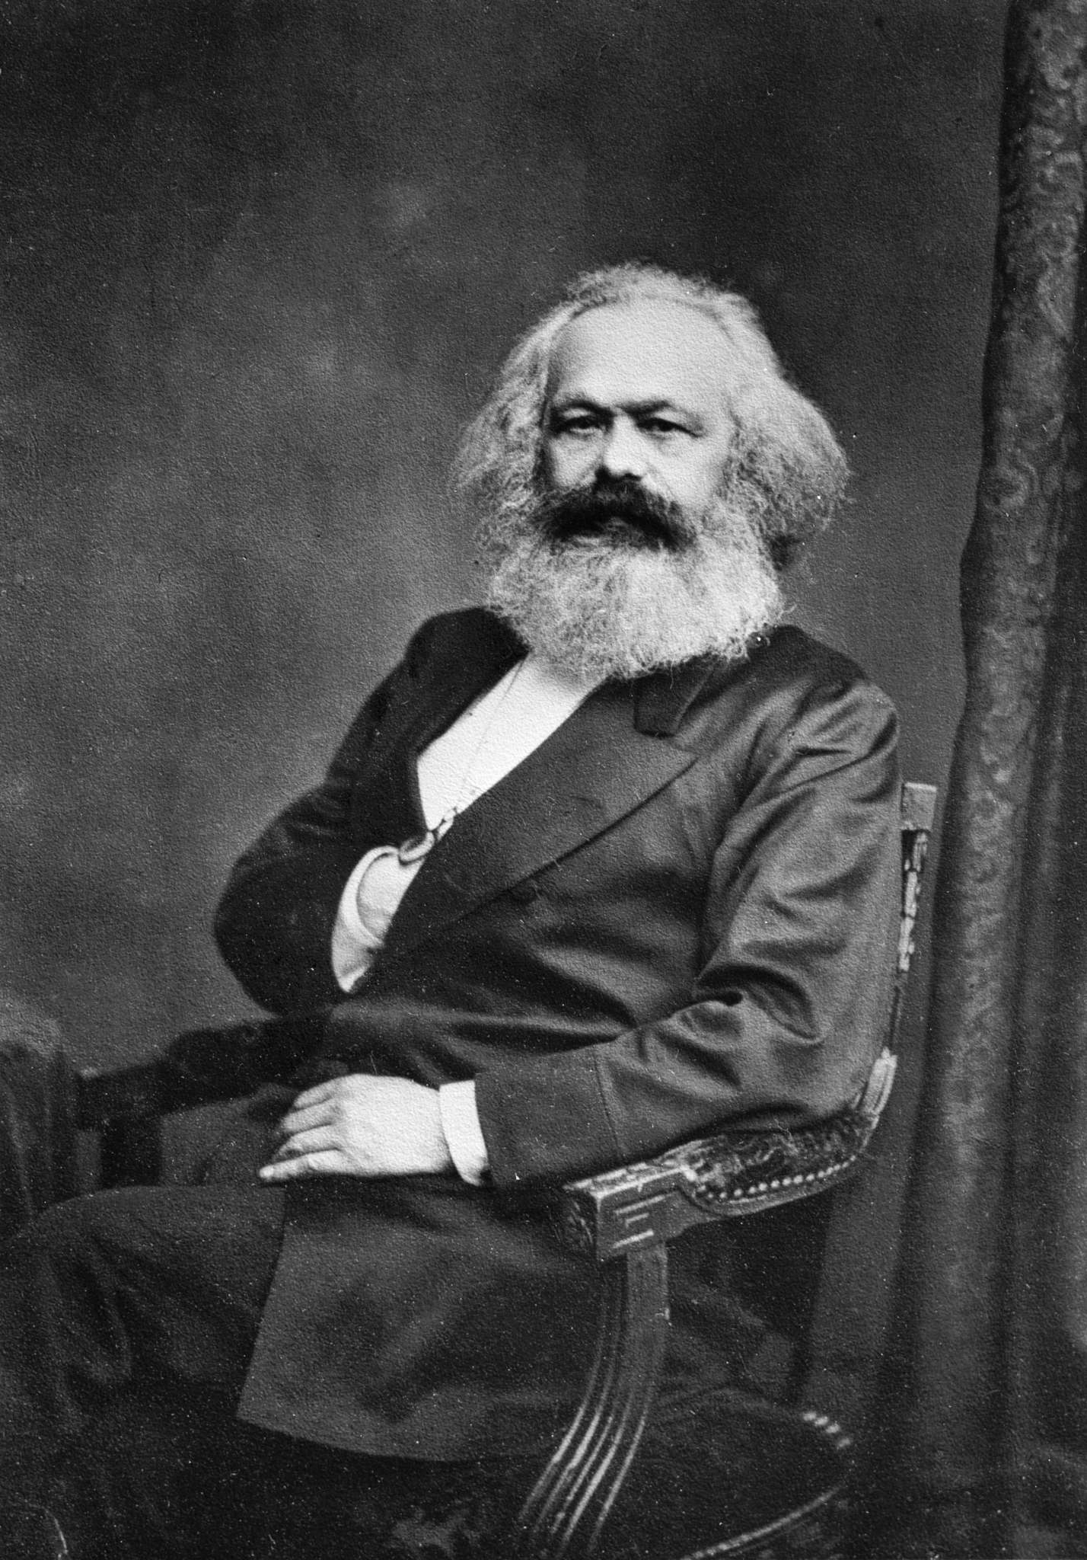
Karl Marx: Technology, Power, and Ownership
The Marxist Critique
Technology is not neutral: it reinforces existing power structures Press and telegraph served bourgeois commercial interests Whoever owns the means of communication controls discourse “The ruling ideas of each age have been the ideas of its ruling class”
Discussion
Who owns today’s media—and does that shape the message?
Karl Marx (1818–1883). Public domain.

Slide 35
Mill vs. Marx: Liberal vs. Radical Visions
John Stuart Mill (1806–1873)
Technology enables individual liberty “Marketplace of ideas” Truth wins through free competition Technology is a neutral tool
Karl Marx (1818–1883)
Technology serves owners “Ruling ideas = ideas of rulers” Liberation requires changing ownership Technology is shaped by power
Same technology, different analyses
Mill: Technology is neutral
Marx: Technology reflects power

Slide 36
Quote: John Stuart Mill, On Liberty (1859)
, John Stuart Mill, On Liberty, Chapter 2 (mill1859liberty)
Context: Mill argues for absolute freedom of expression, claiming that silencing any opinion—even a false one—harms everyone. “If all mankind minus one were of one opinion, and only one person were of the contrary opinion, mankind would be no more justified in silencing that one person, than he, if he had the power, would be justified in silencing mankind. But the peculiar evil of silencing the expression of an opinion is, that it is robbing the human race; posterity as well as the existing generation; those who dissent from the opinion, still more than those who hold it. If the opinion is right, they are deprived of the opportunity of exchanging error for truth: if wrong, they lose, what is almost as great a benefit, the clearer perception and livelier impression of truth, produced by its collision with error.”
! The Assumption
Mill assumes a “marketplace of ideas” where truth wins out. What conditions must hold for this to work?

Slide 37
Marx’s Counterargument
Argument in Standard Form
Those who control the means of communication control the dominant ideas in society.
Under capitalism, the ruling class controls the means of communication.
Therefore, “free” communication under capitalism primarily serves ruling-class interests.
∴ Genuine free communication requires revolutionary change in the ownership of communication technologies.
Discussion
Is Marx right that whoever owns the technology controls the message—or can you think of counterexamples?
37

Slide 38
Social Consequences of Distance Communication
, Benefits
Coordination of reform and labor movements Investigative journalism Scientific collaboration across borders Family connection across vast distances Commercial efficiency
f Harms
Colonialism and imperial coordination Surveillance networks Market manipulation and speculation Sensationalist “yellow journalism” Cultural imperialism
The Pattern Continues
The telegraph and telephone that connected families also coordinated empires.

Slide 39
Lecture Outline
Introduction: Information Technology and Ethics
Revolution 1: Writing Revolution 2: The Printing Press
Revolution 3: Distance Communication Revolution 4: Mass Media
Revolution 5: The World Wide Web Conclusion: Patterns and Lessons

Slide 40




Revolution 4: The Rise of Radio and Television
Key Developments
Radio broadcasting emerges in 1920s Television becomes dominant in 1950s Structural shift: Passive consumption, one-to-many broadcast model Limited spectrum: Corporate and state control
Broadcaster
One speaks, millions listen passively

Slide 41
Who Were Orwell and Arendt?
George Orwell (1903–1950)
Born Eric Arthur Blair in India British novelist, essayist, journalist Fought in Spanish Civil War (1936) Witnessed Stalinist purges firsthand Works: Animal Farm, 1984 Died of tuberculosis at 46
Hannah Arendt (1906–1975)
German-Jewish philosopher Fled Nazi Germany (1933) Stateless refugee for 18 years Covered Eichmann trial (1961) Works: Origins of Totalitarianism, Eichmann in Jerusalem Coined “banality of evil”
Why Their Perspective Matters
Both Orwell and Arendt personally witnessed the rise of totalitarianism, and saw many of their (highly intelligent!) contemporaries fall under its sway. One key question for both concerned the why and how of this phenomenon. Mass media played a central role.
41

Slide 42
George Orwell’s Warning
George Orwell (1903–1950)
1984 (1949): Dystopian novel about totalitarian media control The telescreen: Watches you while you watch it Propaganda slogans: “War is Peace, Freedom is Slavery, Ignorance is Strength” Doublethink: Holding two contradictory beliefs simultaneously
Orwell’s Central Concern
A state monopoly on information makes reality itself malleable. If the Party controls all records, truth becomes whatever the Party says it is.
Historical Context
Orwell wrote 1984 in 1948, having witnessed the rise of Nazi Germany and Stalinist Russia—both masters of propaganda.
42

Slide 43
Quote: George Orwell, 1984
, George Orwell, Nineteen Eighty-Four, Book 1, Chapter 7 (orwell_1984)
Context: Winston Smith works at the Ministry of Truth, rewriting historical records. Here he reflects on the Party’s ultimate demand—not just obedience, but the surrender of one’s own perceptions. “The Party told you to reject the evidence of your eyes and ears. It was their final, most essential command. His heart sank as he thought of the enormous power arrayed against him, the ease with which any Party intellectual would overthrow him in debate, the subtle arguments which he would not be able to understand, much less answer. And yet he was in the right! They were wrong and he was right. The obvious, the silly, and the true had got to be defended. Truisms are true, hold on to that!”
! The Ultimate Goal
Not just to make you believe lies, but to destroy your capacity to distinguish truth from falsehood.

Slide 44
Hannah Arendt on Mass Society
Hannah Arendt (1906–1975)
The Origins of Totalitarianism (1951) The precondition wasn’t ideology but loneliness Breakdown of social bonds leaves individuals vulnerable
, Hannah Arendt, The Origins of Totalitarianism, Ch. 13 (arendt_origins)
“What prepares men for totalitarian domination is the fact that loneliness, once a borderline experience suffered in marginal conditions like old age, has become an everyday experience of the ever-growing masses of our century.”
! The Insight
Mass media doesn’t just spread propaganda—it creates the atomized individuals who crave belonging enough to join movements promising meaning.

Slide 45
Arendt’s Analysis of Propaganda
Argument in Standard Form
Mass society produces atomized individuals who feel superfluous.
The lonely crave coherent explanations that give life meaning.
Mass media delivers such explanations to millions at once.
Totalitarian movements exploit this with all-encompassing ideologies.
∴ Mass media plus mass loneliness creates conditions favorable to totalitarianism.
Discussion
Does social media make us more or less lonely than broadcast media did?

Slide 46
Social Consequences of Mass Media
, Benefits
Mass education Shared cultural experiences Exposure to diversity Rapid news dissemination Public health campaigns Civil rights coverage
f Harms
Propaganda effectiveness “Manufacturing consent” Advertising and consumerism Political manipulation Homogenization of culture Passivity: “The Lonely Crowd”
The Paradox
The same broadcast that showed the Civil Rights Movement to the nation also enabled unprecedented propaganda.

Slide 47
Lecture Outline
Introduction: Information Technology and Ethics
Revolution 1: Writing Revolution 2: The Printing Press
Revolution 3: Distance Communication Revolution 4: Mass Media
Revolution 5: The World Wide Web Conclusion: Patterns and Lessons

Slide 48
Revolution 5: Web 1.0—The Read-Only Web (1990s)
Key Developments
Tim Berners-Lee invents the World Wide Web (1989–1991) Static pages, hyperlinks, information retrieval Early utopian visions: Free information, democratization, disintermediation “Information wants to be free”—Stewart Brand
The Promise
The early web was hailed as the great equalizer—anyone could publish, anyone could access.

Slide 49
Web 2.0—The Participatory Web (2000s)
Key Developments
Social media, user-generated content Platforms: Facebook, YouTube, Twitter/X, Wikipedia, TikTok Promise: Everyone becomes a creator, not just a consumer Reality: The attention economy and algorithmic curation
Web 1.0
User content
Web 2.0
Centralization
Platform Era
Few-to-many
Many-to-many
Many-through-few
New Intermediaries
Platform companies become the new gatekeepers—and they’re driven by advertising revenue.

Slide 50
Web 3.0?—Contested Futures
Competing Visions
Semantic web / AI integration: Machines understand meaning Blockchain and decentralization: Removing intermediaries (?) Virtual and augmented reality: Immersive digital worlds Artificial intelligence: ChatGPT, image generation, and beyond
Utopian Vision
Digital liberation Democratized AI tools Decentralized power
Dystopian Vision
Surveillance capitalism Deepfakes and misinformation Algorithmic control
Discussion
What would a truly decentralized internet look like? Is it even possible?
50

Slide 51
Current Debates
Debate
Free speech vs. moderation
Position A
Maximize expression
Position B
Prevent harm
Privacy vs. convenience Platforms as publishers? Algorithmic amplification AI benefits vs. risks
Protect personal data Yes, they curate
Enable services
No, they’re neutral
Personalization helps Productivity gains
Manipulation harms
Job loss, misuse
The Recurring Question
Who decides? And on what basis?

Slide 52
Lecture Outline
Introduction: Information Technology and Ethics
Revolution 1: Writing Revolution 2: The Printing Press
Revolution 3: Distance Communication Revolution 4: Mass Media
Revolution 5: The World Wide Web Conclusion: Patterns and Lessons

Slide 53
Patterns Across the Revolutions
Revolution | Technology | Optimist | Pessimist | Core Tension
Writing | Alphabet, scrolls | Theuth | Socrates | Memory vs. Remind-
ing
Revolution vs. Reform Free market vs. Own-ership
Information vs. Con-trol
Liberation vs. Surveil-lance
Printing Distance
Mass Media The Web
Movable type Telegraph, phone
Radio, TV
Internet, platforms
Luther Mill
Erasmus Marx
Orwell, Arendt (Us?)
—
Early utopians
Recurring Themes
Each revolution promised liberation and democratization Each enabled new forms of control and manipulation The optimists and pessimists were both partially right The question is always: Who controls the technology, and for what ends?

Slide 54
You Be the Judge: The Phone Ban
The vote
Your school board is voting tonight on a total ban on phones, bell to bell, K–12. You are the deciding vote. Four consultants have filed briefs — and every one of them has been dead for at least fifty years.
Split into four groups. Argue the ban from your thinker’s actual position, in two minutes:
Socrates: the tool counterfeits the capacity it claims to extend
Erasmus: the problem is not the press but the flood of bad print — teach judgment, don’t ban
Marx: ask who owns the device and who profits from the attention
Arendt: ask what happens to a public that shares no common world
Then decide
Which brief would change its own author’s mind if you showed them the last twenty years of evidence?
54

Slide 55
Key Concepts i
Information technology is any technology for creating, storing, transmitting, or processing information—it is ancient, not uniquely modern.
Theuth (Plato’s Phaedrus) is the Egyptian god who invented writing and promised it would aid memory; Socrates argued it would weaken genuine understanding—the first recorded technology debate.
Luther embraced the printing press as a tool for mass reform; Erasmus feared an unfiltered flood of bad ideas. Both turned out to be right.
Mill saw telegraph-era communication as aligned with free markets and progress; Marx analyzed how communication infrastructure reflects and reinforces ownership and class power.
Orwell (Nineteen Eighty-Four) and Arendt (Origins of Totalitarianism) warned that mass media could become instruments of propaganda and totalitarian control.
Disintermediation is the removal of gatekeepers promised by every IT revolution; reintermediation is the new gatekeepers—platforms, telecoms, states—that reliably replace them.

Slide 56
Key Concepts ii
Artificial scarcity is scarcity created by legal or technical means (copyright, DRM) where the underlying resource is naturally non-rivalrous.
Discussion
Which of these thinkers or concepts will matter most as we move into AI, privacy, and labor?

Slide 57
References i

